Slide 1
DATA AND SIGNALS

Slide 2
Data communication
Data communications means the exchange of data between two devices via some form of transmission medium such as a wire cable.
For data communications to occur, the communicating devices must be part of a communication system.
  Which is made up of a combination of hardware (physical equipment) and software (programs).
Effectiveness of a data communications system depends on four important characteristics:
  delivery, accuracy, timeliness, and jitter.

Slide 3
Characteristics of data communicaton
Delivery:
  The system must deliver data to the correct destination.
  Data must be received by the intended device or user and only by that device or user.
Accuracy:
  The system must deliver data accurately.
  Data that have been altered in transmission and left uncorrected are unusable.
Timeliness:
  The system must deliver data in a timely manner.
  Data delivered late are useless. In the case of video and audio, timely delivery means delivering data as they are produced, in the same order that they are produced, and without significant delay.
  This kind of delivery is called real-time transmission.
Jitter:
  Jitter refers to variation in packet (data) arrival time. It is the uneven delay in the delivery of audio or video packets.

Slide 4
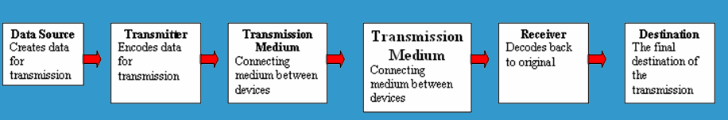
5 Basic Components
Every communication system has 5 basic requirements
Data Source (where the data originates)
Transmitter (device used to transmit data)
Transmission Medium (cables or non cable)
Receiver (device used to receive data)
Destination (where the data will be placed)

Slide 5
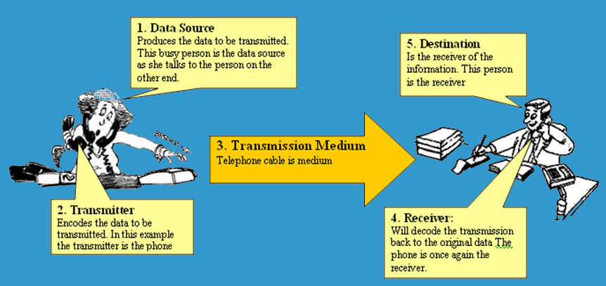
5 Basic Components

Slide 6
Data Transmission
Data transmission refers to the movement of data in form of bits between two or more digital devices.
This transfer of data takes place in some form of transmission media.

Slide 7
Transmission Mode
Transmission mode defines the direction of the flow of information between two communication devices i .e ,
  It tells the direction of signal flow between the two devices
Transmission mode refer to the manner in which data is sent over the underlying medium.
Transmission mode can be divided into two categories:
  Serial – which transmits one bit at a time
    Serial transmission is further categorised according to timing of transmissions
  Parallel – multiple bits are sent at the same time.

Slide 8
Parallel Transmission
Parallel transmission allow transfers of multiple data bits at the same time over separate transmission media.
Parallel transmission is used with a wired medium that uses multiple, independent wires.
Signals on all wires are synchronized so that a bit travels across each of the wires at precisely the same time.

Slide 9
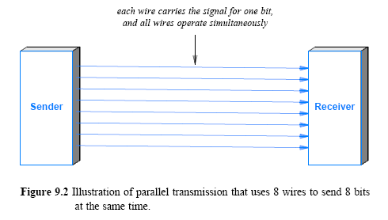
Parallel Transmission

Slide 10
In addition to parallel wires that each carry data
    A parallel interface contains other wires that allow the sender and receiver to coordinate.
  Second, to make installation and troubleshooting easy
    The wires for a parallel transmission system are placed in a single physical cable.
A parallel mode of transmission has two main advantages:
  High speed: it can send many bits at the same time
    a parallel interface can operate many times faster than an equivalent serial interface
  Match to underlying hardware: Internally, computer and communication hardware uses parallel circuitry
    a parallel interface matches the internal hardware well.

Slide 11
Serial Transmission
Serial transmission sends one bit at a time.
It may seem that anyone would choose parallel transmission for high speeds
  However, most communication systems use serial mode
There are two main reasons
  First, serial networks can be extended over long distances at much less cost.
  Second, using only one physical wire means that there is no timing problem caused by one wire being slightly longer than the other.
Sender and receiver must contain a hardware that converts data from the parallel form used in the device to the serial form used on the wire.

Slide 12
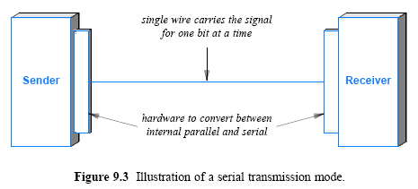
Serial Transmission

Slide 13
Timing of Serial Transmission
Serial transmission can be divided into three categories (depending on how transmissions are spaced in time):
Asynchronous transmission can occur at any time
  with an arbitrary delay between the transmission of two data items
Synchronous transmission occurs continuously
  with no gap between the transmission of two data items
Isochronous transmission occurs at regular intervals
  with a fixed gap between the transmission of two data items

Slide 14
Asynchronous Transmission
Allows the transmission medium to be idle for an arbitrary time between two transmissions.
The sender and receiver are not synchronised.
The sender sends only one character at a time.
Each character of data is treated independently
Data is transmitted one character at a time where each character is 5 or 8 bits in length
Each character begins with a start bit that alerts the receiver that a character is arriving.
The receiver samples each bit in the character and then looks for the beginning of the next character.
There can be idle time between each character.

Slide 15
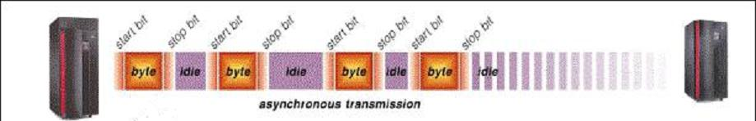
Asynchronous
Asynchronous has a much higher overhead costs.

Slide 16
Synchronous Transmission
Used for large blocks of data.
Each block of data is formatted as a data frame (packet) that includes a starting and an ending flag, and is transmitted in a steady stream without start and stop codes.
The block may be many bits in length.
Synchronous transmits bits of data continually with no idle time between bits.
The sender and receiver constantly remain synchronized.
Synchronisation is achieved by sending a ‘start’ frame and a ‘stop’ frame.
To prevent timing drift between transmitter and receiver, their clocks must be synchronized.
  One possibility is to provide a separate clock line between transmitter and receiver.
  The other alternative is to embed the clocking information in the data signal.

Slide 17
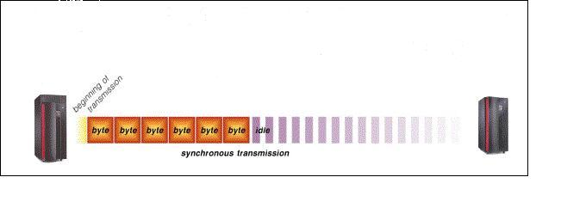
Synchronous

Slide 18
Isochronous
  is designed to provide steady bit flow for multimedia applications
Delivering such data at a steady rate is essential
  because variations in delay known as jitter can disrupt reception (cause pops or clicks in audio/make video freeze for a short time)
In real-time audio and video, in which delays between frames are not acceptable, synchronous transmission fails.
For example, TV images are broadcast at the rate of 30 images per second; they must be viewed at the same rate.
If each image is sent by using one or more frames, there should be no delays between frames.
For this type of application, synchronization between characters is not enough; the entire stream of bits must be synchronized.
The isochronous transmission guarantees that the data arrive at a fixed rate.

Slide 19
Simplex, Half-Duplex and Full-Duplex Transmission
A communications channel is classified as one of three types:
  (depending on the direction of transfer)
  Simplex - can only transfer data in a single direction
  Half-Duplex
  Full-Duplex - allows transmission in two directions simultaneously

Slide 20
Simplex Mode
Simplex can only transfer data in a single direction
Information is sent in only one direction.
Devices connected in simplex mode is either sent only or receive only that is one device can only send, other device can only receive.
Communication is unidirectional.
Example: TV, Radio Broadcasting,

Slide 21
Half Duplex
A half duplex channel can send and receive, but not at the same time.
In half duplex transmission data can be sent in both directions, but only in one direction at a time.
Both the connected device can transmit and receive but not simultaneously.
When one device is sending the other can only receive and vice-versa.
Example: Police radio, walkie-talkies

Slide 22
Full Duplex
In full duplex transmission, data can be sent in both directions simultaneously.
Both the connected devices can transmit and receive at the same time.
Allows transmission in two directions simultaneously
Full duplex represents bi-directional system.
In full duplex mode, signals going in either direction share the full capacity of link.
Example: Telephone conversation

Slide 23
Data And Signals
Information can be in form of data, voice, picture, and so on.
Information usable to a person or application is not in a form that can be transmitted over a network.
Information must be converted into a form that a transmission media can accept.
Transmission media work by conducting energy along a physical path.
So a data stream of 1s and 0s must be turned into energy in the form of electromagnetic signals.
A signal is the representation of a certain information.

Slide 24
Signals and data are classified as Analog or Digital.
Analog refers to information that is continuous waveform e.g. music, video etc.
  An example of analog data is the human voice.
Digital refers to information that has discrete states. (0s and 1s)
  An example of digital data is data stored in the memory of a computer in the form of 0s and 1s.

Slide 25
Digital signals:
  Are cheaper.
  Are more accurate
  Are more reliable
  Have fewer transmission errors
  Are easier to maintain than analog signals.
Vast structures exist for analog signaling and much of it can be adapted to transport digital signals as well.
Telephone network, cable TV infrastructure and partially every form of wireless communication are naturally analog transmission media but have been adapted for digital transmission.

Slide 26
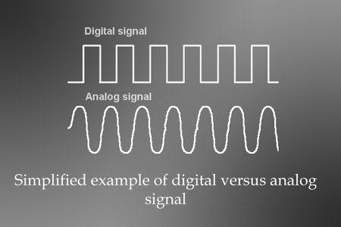

Slide 27
Analog data can be encoded as an analog signal, for example, cassette tape player and audio video component of TV program.
Digital data is regularly represented by digital signal, for example, email.
Also, analog data is also commonly encoded with digital signals.
When you scan an image or capture sound on the computer, you are converting analog data to digital signal.
Digital transmission has replaced analog transmission except the telephone network.
Although voice is the primary signal carried by the network, this network is now widely used to carry digital information or data as well.
A modem is used in telephone network to convert digital signals to analog for transmission.
A modem also converts analog signal received from a telephone network into digital form.

Slide 28
Transmission rate and Bandwidth
In computer networks, bandwidth is used as a synonym (substitute) for data transfer rate,
  the amount of data that can be carried from one point to another in a given time period (usually a second).
Network bandwidth is usually expressed in bits per second (bps);
Modern networks have speeds measured in millions of bits per second (megabits per second, or Mbps) or billions of bits per second (gigabits per second, or Gbps).
Different applications require different bandwidths.
An instant messaging conversation might take less than 1,000 bits per second (bps);
Standard definition video works at 1 megabit per second (Mbps), but HD video wants around 4 Mbps, and HDX more than 7 Mbps.

Slide 29
Bandwidth is also described as the range of frequencies that can be transmitted with minimum distortion.
Bandwidth refers to a range of frequencies used to transmit a signal.
  Frequency of a signal is the number of cycles per second and is expressed in units called Hertz (Hz for short). I Hz is 1cycle per second.
  Frequency can be described as the number of waves that pass a fixed place in a given amount of time.
Bandwidth is equal to the rate of information transfer or transmission rate, which is equal to amount of information that is communicated from the source to the destination in a fixed amount of time typically one second.
Bandwidth is also a measure of transmission capacity of a communication medium.
There is a general rule that relates bandwidth and information capacity.
Hartley’s Law, states that the amount of information that can be transmitted in a given time is directly proportional to the bandwidth.

Slide 30
It is clear that the greater the channel bandwidth the greater the amount of information you can transmit in a given time.
You can still transmit the same information over a narrower channel except that it will take longer.
High bandwidth applications include:
  Web browsing,
  E-commerce
  Audio and video streaming
  Real time document sharing
  Video conferencing
  On line gaming
  Digital TV
For digital devices, the bandwidth is expressed as bits per second (bps).
For analog devices, bandwidth is expressed in cycles per second or Hertz (Hz).
This type of bandwidth is measured in hertz and is often referenced in signal processing applications.
Bandwidth measures how much data can flow through a specific connection at one time.

